Slide 1


Slide 2
IDENTIFY, CLASSIFY AND PARK ON A CITY-CENTER STREET

Slide 3
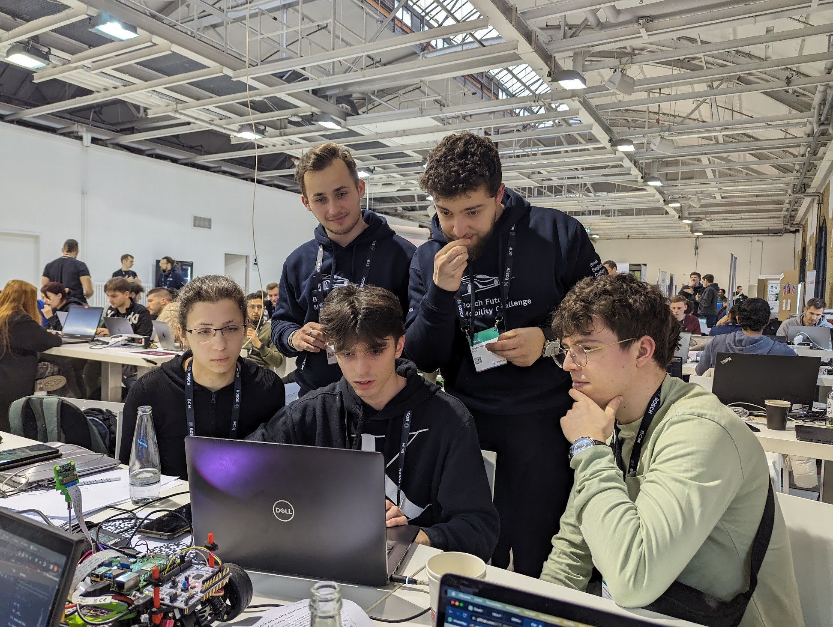
Notes:
actual impact and realistic
hand on project, and amazing results in the end!

Slide 4
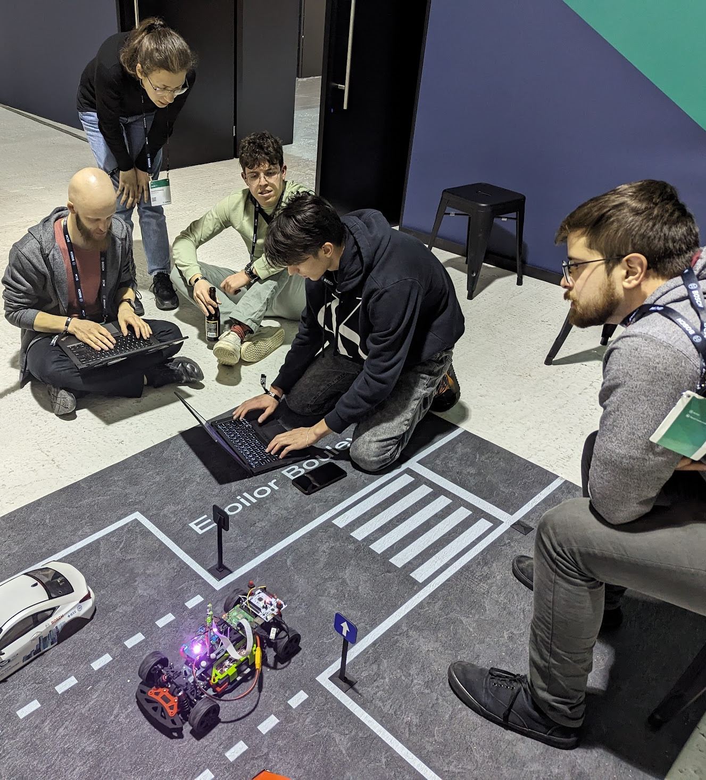
Automated Parking
Implemented autonomous systems
Time Efficiency
Improved Safety
Enhanced User Experience
Improves traffic flow

Slide 5
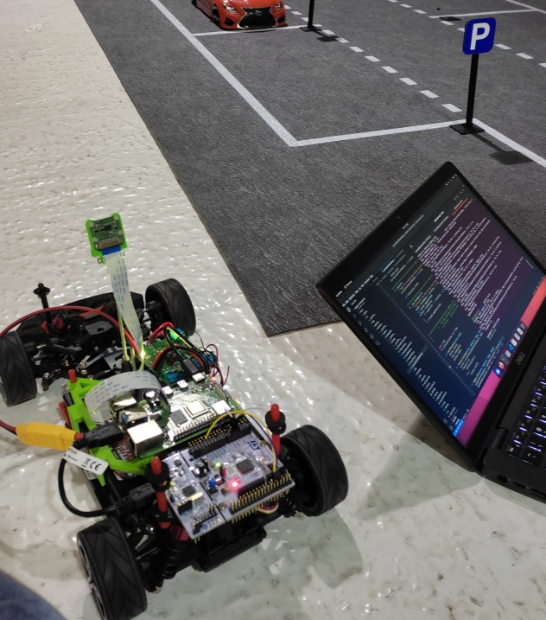
Visual Recognition of Traffic Signs
Implemented visual recognition
Cars understand traffic signs
Act accordingly
Enhances safety
Improves traffic flow

Slide 6
Advantages
cheap production
and simple implementation
universal use cases
actual impact on people's lives
Notes:
cheap production
and simple implementation
universal use cases
actual impact on people's lives

Slide 7
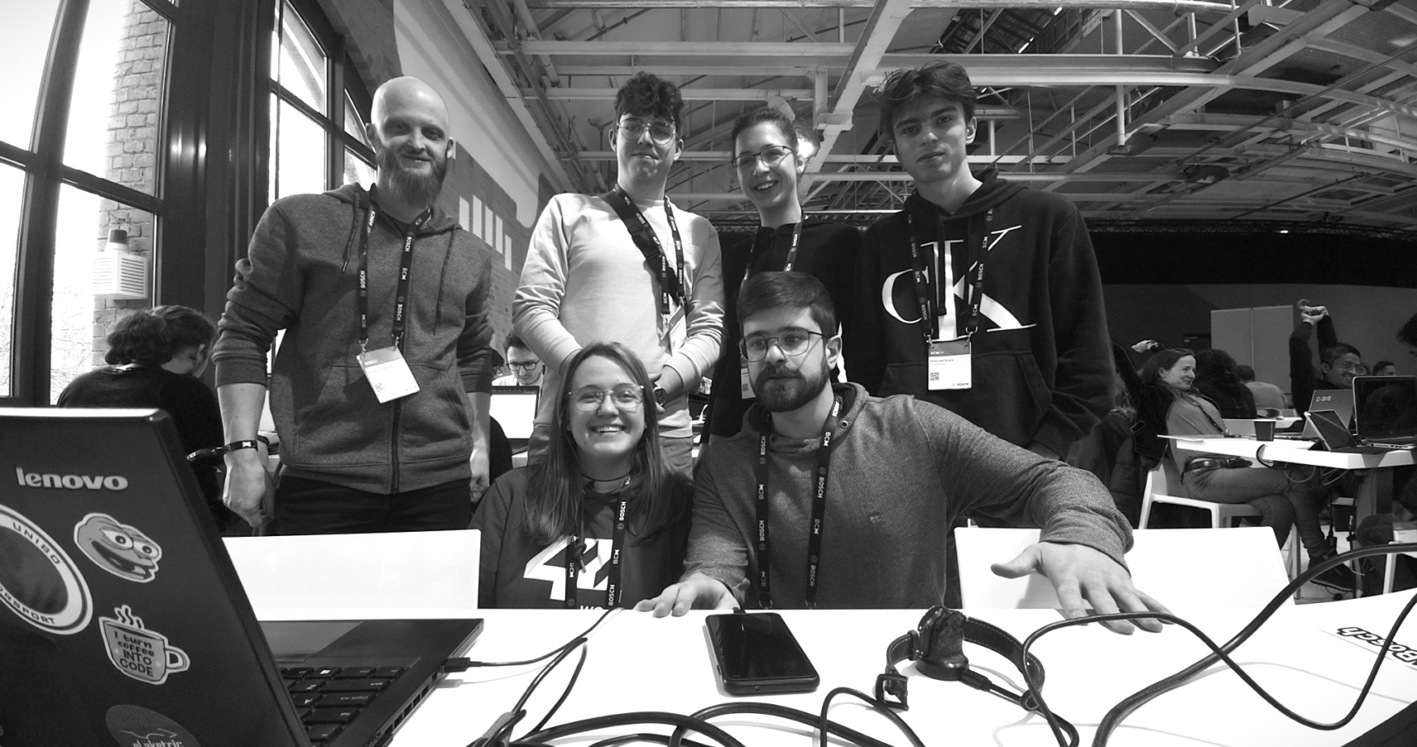
MICHAŁ
KAROLINA
JĘDRZEJ
EMANUEL
ELLEN
PAULO

Slide 8
THANK YOU!

